Slide 1



Slide 2

Object oriented programming
June 2018

Slide 3
Content
Agenda:
What is OOP
Fundamental principles of OOP
Inheritance
Abstraction
Encapsulation
Polymorphism
Exception handling
OOP modeling

Slide 4
What is OOP

Slide 5

Fundamental principles of OOP

Slide 6
Inheritance

Slide 7
Inheritance
Inheritance allows child classes to inherit the characteristics of an existing parent (base) class
- Attributes (fields and properties)
- Operations (methods)
Child class can extend the parent class
- Add new fields and methods
- Redefine methods (modify existing behavior) – virtual keyword
- Restrict extending – sealed keyword
A class can implement an interface by providing implementation for all its methods

Slide 8
Inheritance – benefits and usage
Benefits
- Extensibility
- Reusability
- Provides abstraction
- Eliminates redundant code
Object relationships
- “is-a” – appropriate for inheritance(dog “ïs-a” animal)
- “has-a” – inappropriate for inheritance(dog “has-a” tail)
A class can implement an interface by providing implementation for all its methods

Slide 9
Inheritance – example
Game
SinglePlayerGame
MultiplePlayersGame
Minesweeper
Solitaire
BoardGame
…
Chess
Backgammon

Slide 10
Inheritance in .NET
IOException derives from SystemException and it derives from Exception
A class can implement several interfaces - this is .NET’s form of multiple inheritance:
List<T> implements IList<T>, ICollection<T>, IEnumerable<T>
An interface can implement several interfaces:
E.g. IList<T> implements ICollection<T> and IEnumerable<T>

Slide 11
Abstraction

Slide 12
Abstraction
Allows us to represent a complex reality in terms of a simplified model
Abstraction highlights the properties of an entity that we need and hides the others
As a result user is able to perform complex actions on top of the provided abstraction without understanding or thinking about all the hidden complexity

Slide 13
Abstract data types
Ilist<T> in .NET Framework
«interface»
IList<T>
+Add(item : Object)
+Remove(item : Object)
+Clear()
…
LinkedList<T>
List<T>

Slide 14
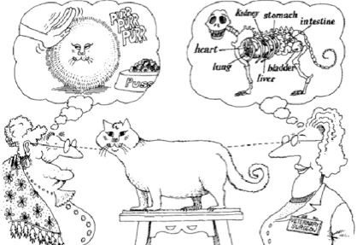
Abstraction

Slide 15
How to achieve abstraction in .NET
Abstract classes
Interfaces
Inheritance
Using access modifiers(encapsulation)

Slide 16
Encapsulation

Slide 17
Encapsulation
Hides implementation details
Class only announces some operations (methods) available for outside usage – its public interface. Other ones are hidden(encapsulated)

Slide 18
Achieving encapsulation with access modifiers
Public
Protected
Protected internal
Private
Private protected – from C# 7.2

Slide 19
Encapsulation - benefits
Ensures that structural changes remain local
- Changing the class internals does not affect any code outside of the class
- Changing methods implementation does not reflect the clients using them
Hiding implementation details reduces complexity, which results in easier maintenance
Make the code more abstract and easier to work with

Slide 20
Polymorphism

Slide 21
Polymorphism
Polymorphism is when you can treat an object as a generic version of something, but when you access it, the code determines which exact type it is and calls the associated code
Polymorphism describes a pattern in object oriented programming in which classes have different functionality while sharing a common interface
Polymorphism allows abstract operations to be defined and invoked

Slide 22
How polymorphism works
Polymorphism ensures that the appropriate method of the subclass is called through its base class interface
Polymorphism is implemented using a technique called late method binding.
- The exact method to be called is determined at runtime, just before performing the call
- Applied for all abstract / virtual methods
- Late binding(runtime time) is a bit slower than early binding(compile time)

Slide 23
Polymorphism example
Abstract class
Figure
Abstract action
+CalcSurface() : double
Concrete class
Square
Circle
-x : int
-y : int
-size : int
-x : int
-y : int
-radius: int
Overriden action
Overriden action
override … CalcSurface()
{
return size * size;
}
override double CalcSurface()
{
return PI * radius * raduis;
}

Slide 24
How to achieve polymorphism
Abstract operations are defined in a base class(declared as abstract or virtual) and implemented in child classes
Abstract operations are defined in an interface and implemented in a class, which implements the interface

Slide 25
Polymorphism Demo

Slide 26
Exception handling

Slide 27
Exception handling
In OOP exception handling is the main paradigm for error handling
Exceptions are handled though the try-catch-finally constructs

Slide 28
Exceptions hierarchy
Exceptions in .NET Framework are organized in a object-oriented in class hierarchy

Slide 29
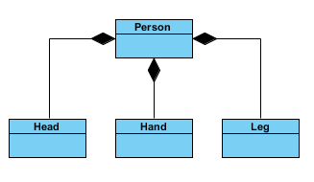
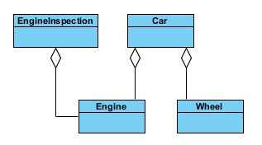
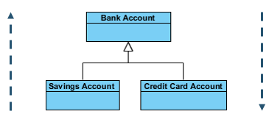
OOP modeling
Generalization
Specialization
Association
- Composition
- Aggregation

Slide 30






Q&A
Any Questions

Slide 31
Q&A
THANKS ☺

